Slide 1
Emily Thomson
Senior Lecturer
Department of Economics & Law
Session 2: Women and Work

Slide 2
Session 2: Learning Outcomes
Understand the gendered nature of labour market participation
Explore mainstream economic versus feminist economic explanations of women’s unequal access to paid work
Consider the role of unpaid work in the economy
Explore the issue of self-employment as a case study

Slide 3
Women in Scotland’s Labour Market
In November 2018, 1,273,000 women were employed in Scotland; the employment rate for women was 71%, compared to 79% for men
Part-time employment accounts for 42% of all women’s employment compared to only 12% of men’s
Economic inactivity rates for women were 26.5% compared to the male rate of 18%).
The reasons for economic inactivity differ by gender: ‘Looking after family/home’ is given as the reason for inactivity for 26% of inactive women compared to only 6% of inactive men.

Slide 4
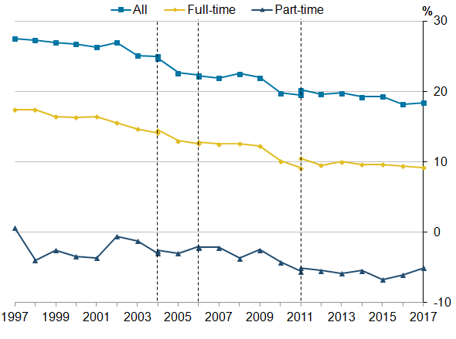
The Gender Pay Gap

Slide 5
Causes of the Gender Pay Gap
Horizontal Occupational Segregation: Women’s employment clusters around public administration, education and health, with almost half of women in Scotland working in these sectors.
Explore the Gender Pay Gap by occupation:
https://www.ons.gov.uk/employmentandlabourmarket/peopleinwork/earningsandworkinghours/articles/explorethegenderpaygapandtestyourknowledge/2017-10-26#interactive
Vertical Occupational Segregation:
Women under-represented at highest levels: 27% of Chief Executives and Senior Officials
30% of Managers and Directors

Slide 6
Why do female dominated occupations pay less?
Devaluation theory;
‘female typical’ work tasks associated with care and reproductive activities devalued by the market
‘female typical’ working time arrangements; do not correspond to the ‘ideal worker’ model

Slide 7
Close the Gap: The Gender Penalty
As well as segregation….
Bonus earnings
Company size
The “gender residual”: The most significant cause of Scotland’s pay gap is gender itself; in other words, the penalty for being a woman.
The gender residual is most commonly attributed to gender discrimination in the labour market, which manifests in the structural inequalities and systemic disadvantage that women experience in entering and progressing in employment.

Slide 8
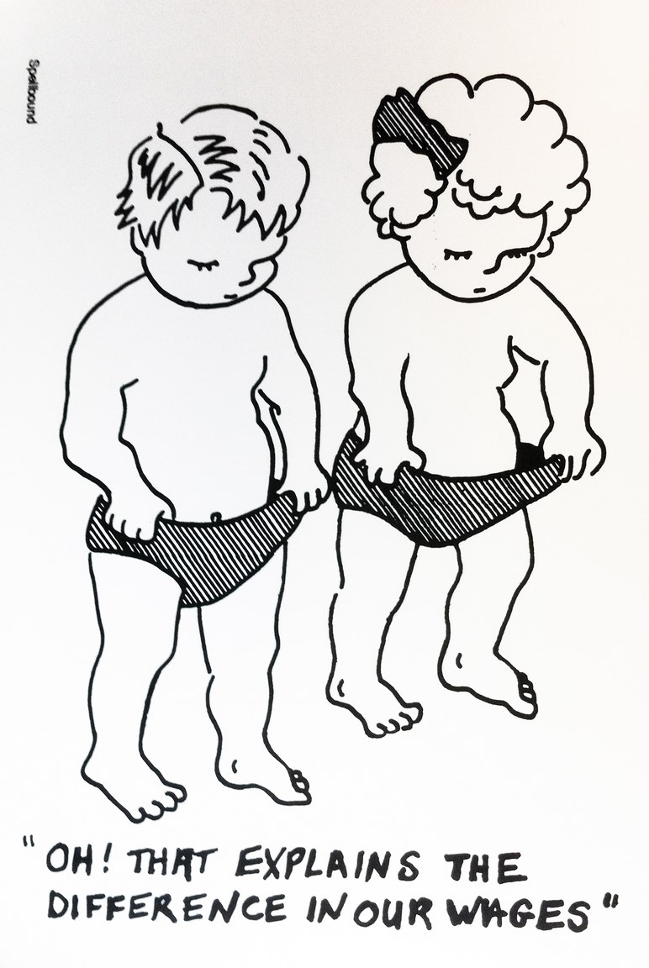
Explanations
Mainstream economic explanations:
Human capital theory; ‘Preferences’
Feminist/gender explanations:
Social construction of gender;
‘Structures of Constraint’

Slide 9
Mainstream economics:
Human capital theory:
Causal relationship between skills and qualifications and between skills and wages and remuneration
Less demand for ‘female typical’ skills in pure market model, women’s skills perceived as ‘natural’
Gender based preferences for ‘female typical’ working time arrangements

Slide 10
Graduate Gender Pay Gap
Department for Education statistics 2015/16
a year after graduating, women were earning about a typical salary of £18,300, compared with £19,900 for men (£1,600 less)
three years after graduating, women typically earned £21,800, compared with £24,200 for the men (£2,400 less)
five years post-graduation, the figures were £24,500 for the women and £27,800 for the men (£3,300 less)
at 10 years, typical salaries were £27,100 for the women and £35,100 for the men (£8000 less)

Slide 11
‘Motherhood penalty’
refers to the pay gap between working mothers and similar women without dependent children
By the age of 42, mothers who are in full-time work are earning 11% less than full-time women without children
When personal characteristics – such as education, region and occupational social class – are controlled for, the motherhood pay penalty for those in full- time work falls to 7%

Slide 12

Feminist/Gender explanations:
Social construction of ‘gender’; notions of gender formed through a process of socialisation
Family
Schools
Post-compulsory Education
Modern Apprenticeships

Slide 13
Unpaid work:
Activities that take place outside the cash nexus.
(i) work on the household plot (or ‘subsistence’) for household consumption
(ii) activities such as the collection of water and firewood for self-consumption; and
(iii) unpaid care of one’s child, elderly parent or friend affected by a chronic illness
Households are more than suppliers of labour
Preferences for market production depend on preferences for household production
Social expectations impacts on ‘preferences’ for household production – gender dimension

Slide 14
Distribution of Unpaid Work
Between regions – women do an average of 30 minutes more in developed countries and 50 minutes more in developing countries
Gender differences have narrowed over time: women do less domestic work, men do (slightly!) more childcare
Rich vs poor – ability to purchase market substitutes, infrastructure
Cost and benefits?

Slide 15
Distribution of unpaid work (UK):
UK gender gap in unpaid work is around 2 hours per day (OECD average is 2.5 hours)
As women move into paid work, they still do more unpaid work than men
E.g. non-working fathers in the UK devote less time to childcare (63 minutes per day) than working mothers (81 minutes per day)
In 2016, the value of the UK’s unpaid household service work was estimated at £1.24 trillion: overall unpaid household service work was equivalent to 63.1% of gross domestic product (GDP)
Notes:
UK household satellite accounts 2010 – value of unpaid childcare was £343 billion (23% of GDP)

Slide 16
Benefits
Wellbeing effects
Underpins ability to perform paid work
Care – development of children
Care – recovery
Costs
Energy (health)
Foregone employment (and associated income and social security entitlements)
Enjoyment of leisure time
Depletion of human capital
Unrecognised skills acquisition
Loss of ‘status’

Slide 17
Valuing Household Production
Replacement cost method (low estimates)
Use wages paid in a general category such as ‘domestic worker’ or value each task separately such as childcare
https://visual.ons.gov.uk/the-value-of-your-unpaid-work/#calculator
Opportunity cost method (higher estimates)
Value hours in unpaid work at wages foregone

Slide 18
Discussion Questions
Google ONS unpaid work calculator
Think of all the activities you do in a day – which would the economist call ‘productive’ (i.e. have a market value)? Does this seem fair/justified?
What impact might economic recession have on levels of unpaid work being done in the economy?
What would happen in the economy if women stopped doing unpaid work?

Slide 19
Mainstream Economics
Gender inequalities a natural feature of global political economy
A focus on the productive potential of women
Problem – women
Feminist Economics
Explicit calls for more gender equal outcomes
A focus on recognising the existing productivity of women
Problem – unequal social and economic structure

Slide 20
Summary
Women and men have different attachments to paid AND unpaid work
These differences impact on their access to economic resources (inequality)
Differences explained in mainstream economics framework as ‘free choice’
Other frameworks emphasise ‘gender’ as a social construct – feminist economics – redefine notions of ‘work’ as paid and unpaid

Slide 21
Resources
Business Case for Gender Equality: https://www.researchgate.net/publication/228423974_Do_Ends_Justify_Means_Feminist_Economics_Perspectives_on_the_Business_Case_for_Gender_Equality_in_the_UK_Labour_Market
European Employment Strategy: https://www.researchgate.net/publication/24080961_Reflections_on_gender_mainstreaming_An_example_of_feminist_economics_in_action
Gender Pay Gap: https://www.researchgate.net/publication/257663706_The_Gender_Pay_Gap_Challenging_the_Rationalizations_Perceived_Equity_Discrimination_and_the_Limits_of_Human_Capital_Models
Motherhood Pay Gap: http://ilo.org/global/publications/working-papers/WCMS_348041/lang--en/index.htm
Graduate Outcomes: https://assets.publishing.service.gov.uk/government/uploads/system/uploads/attachment_data/file/790223/Main_text.pdf

